Slide 1
PSYCHOMOTOR SKILL MANAGEMENT
Parut Singhapun 5710503495
11 September 2017

Slide 2
OUTLINE
Objectives
9-Square-Table
Psychomotor Skill Management
Double Table
Equipment

Slide 3
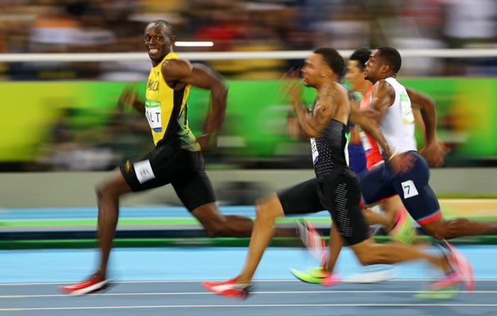
OBJECTIVES
To improve the athlete’s performance
To improve the reaction skill of the testers

Slide 4

BACKGROUND
Some of the tester don’t’ know the result of the test
Testers don’t have his/her own result history
Testers don’t know their rank compared to the other

Slide 5
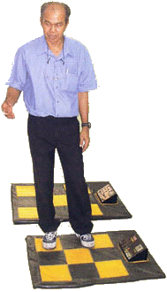
9-SQUARE-TABLE
Inventor : Assoc. Prof. Charoen Krabuanrat
Goal : Practice brain and body skills

Slide 6
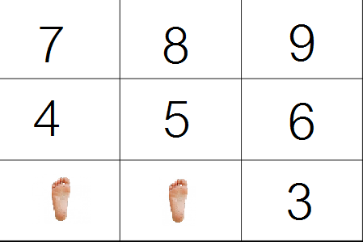
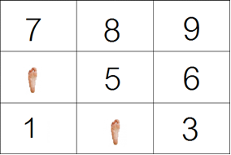
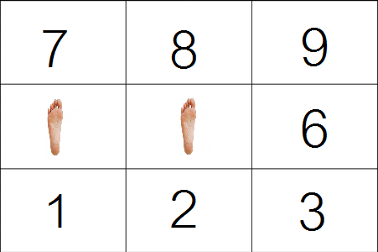
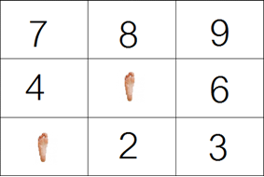
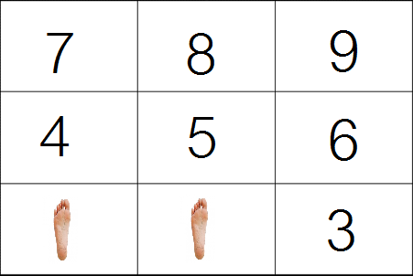
HOW TO PLAY
AS FAST AS YOU CAN!

Slide 7
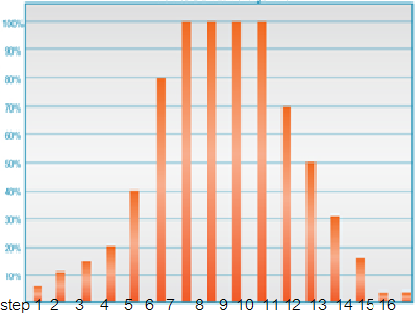
PSYCHOMOTOR SKILL MANAGEMENT
Get data from tester and analysis the results
Examiner can change form of input to his/her own idea or create his/her new form
Monitoring the output in form of graph and statistic detail

Slide 8
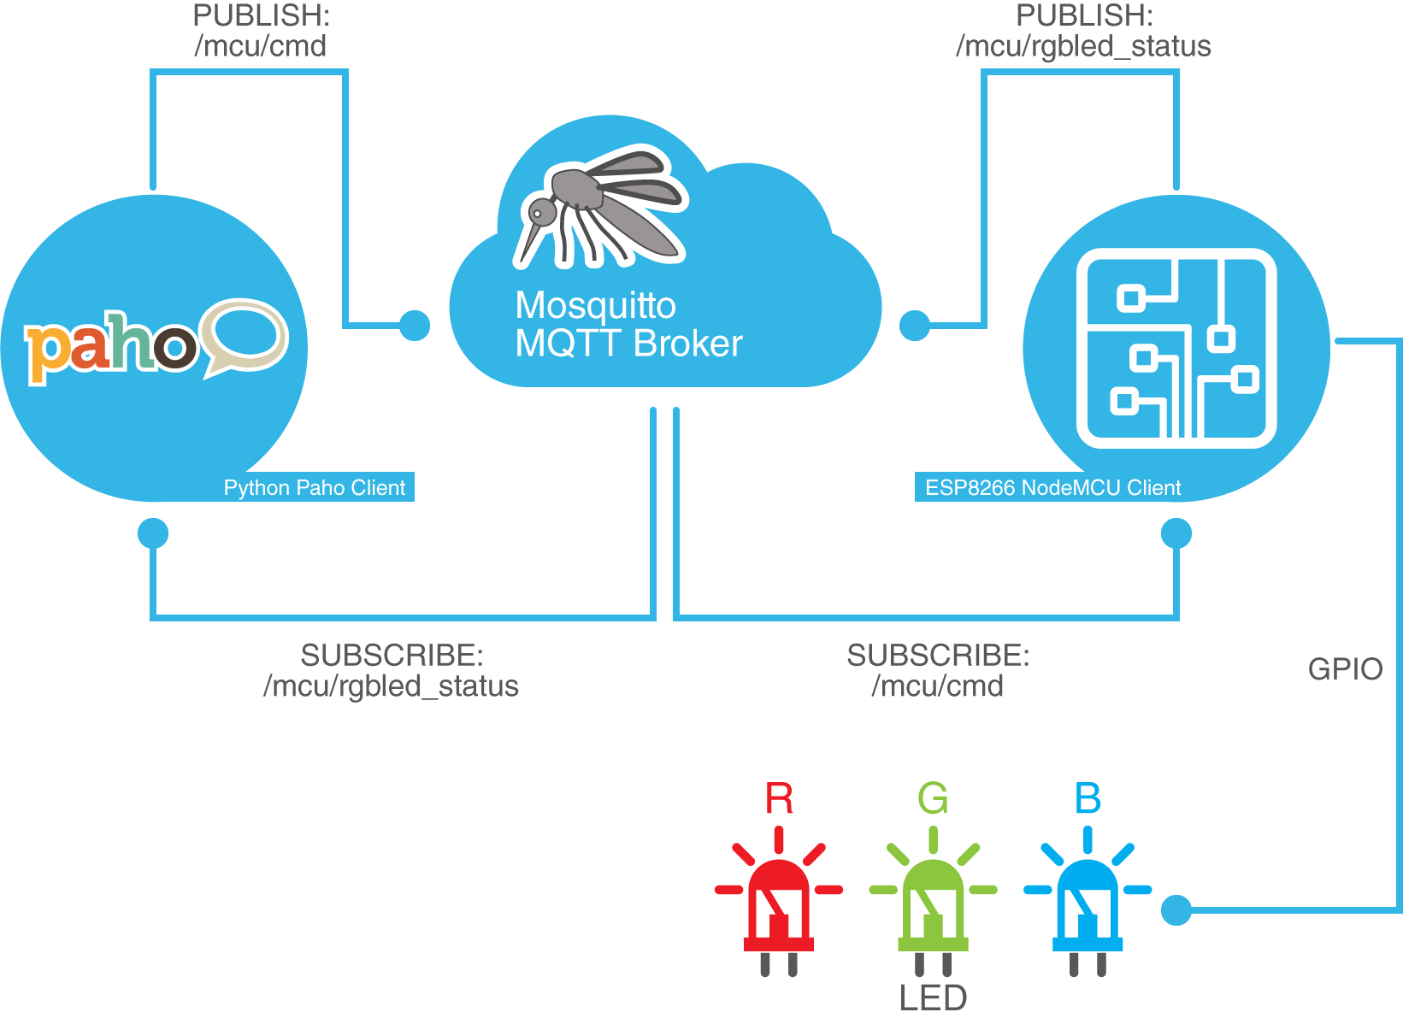
MQTT PROTOCOL

Slide 9
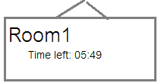
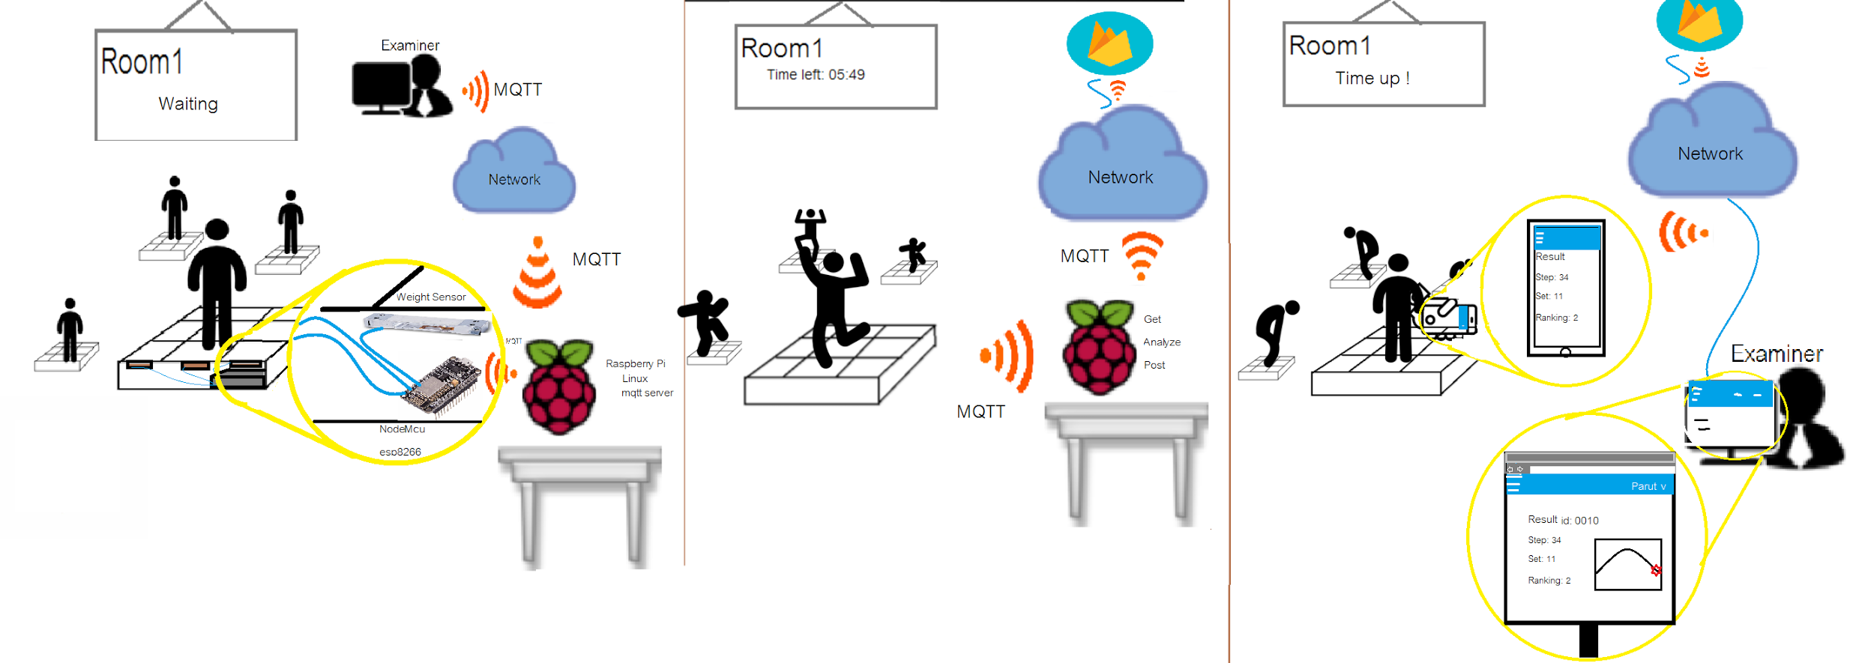
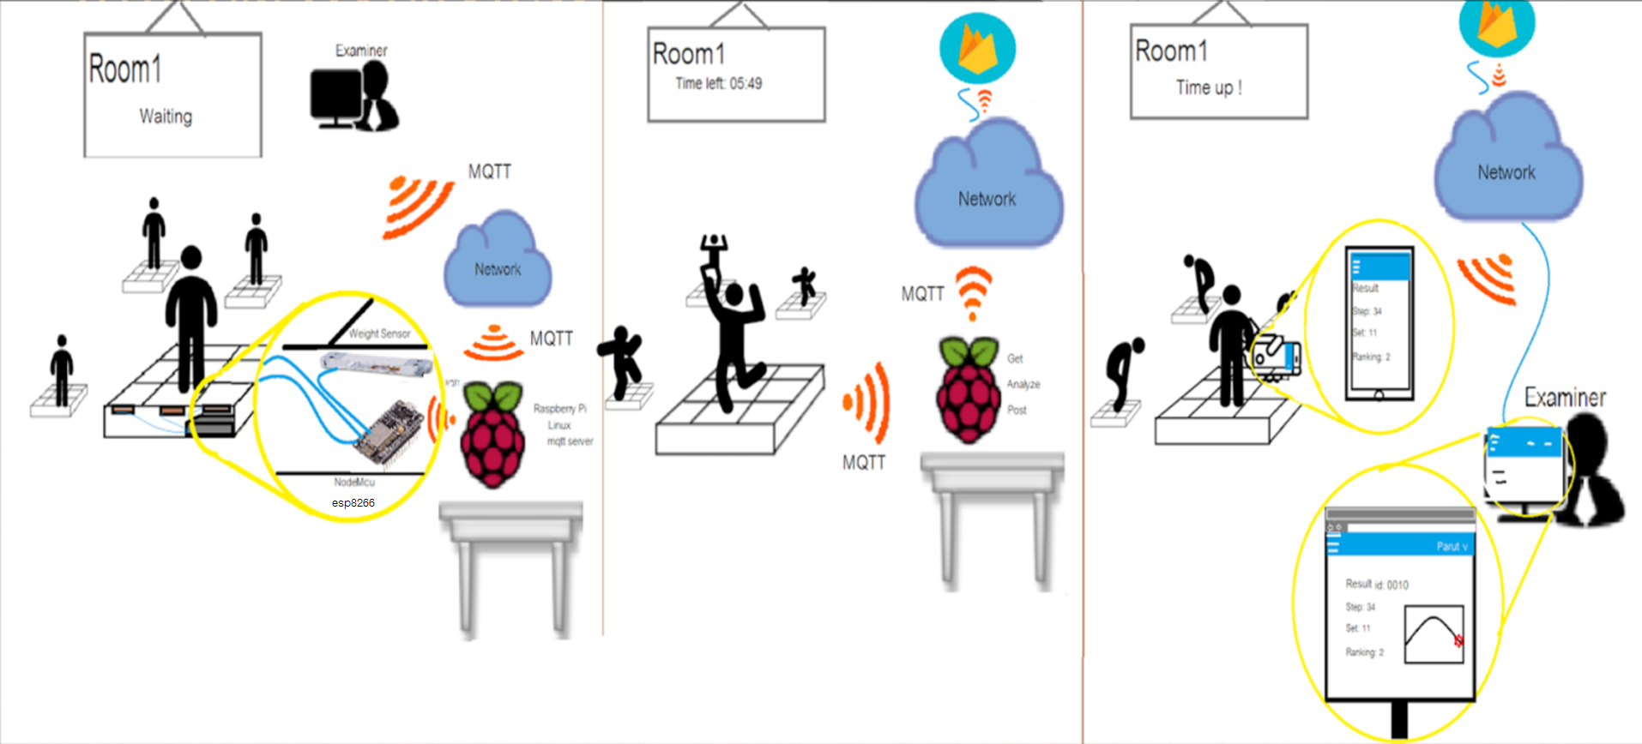





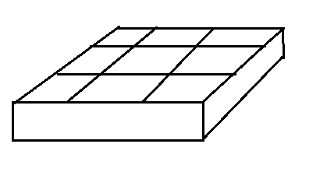




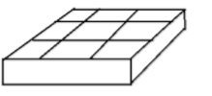
SYSTEM OVERVIEW

Slide 10
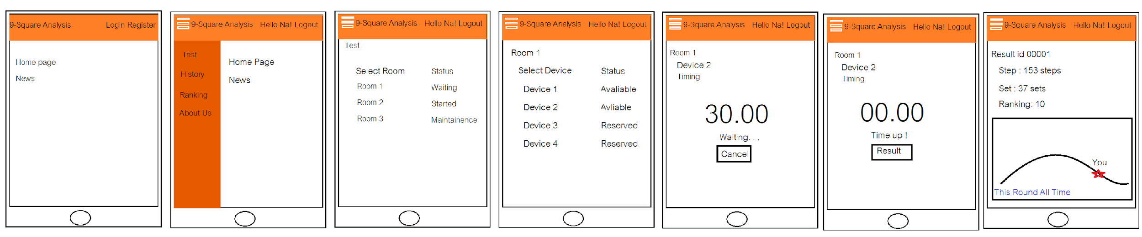
MOCK UP

Slide 11
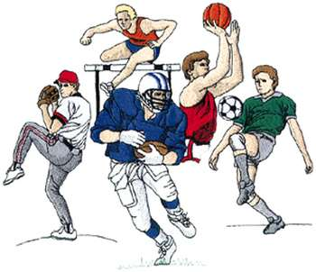

TARGET
Athlete of Kasetsart University
Faculty of Education, Kasetsart University

Slide 12
REQUIREMENT
The format pattern MUST be accurate 100%.
Can show output in form of (Step, Set)
Examiner can select form to play and can create the format pattern themselves
(Optional) Double Table

Slide 13
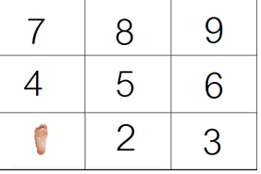
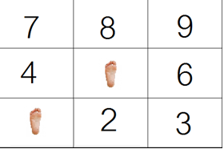
DOUBLE TABLE
Two player alternate play by the first player add his/her first step
The second player must repeat it and add his/her own step

Slide 14
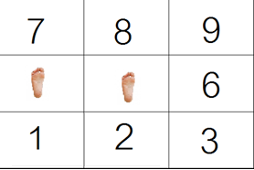
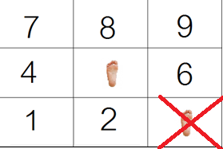
3. First player must repeat it and add his/hers.
4.Repeat until someone fail

Slide 15
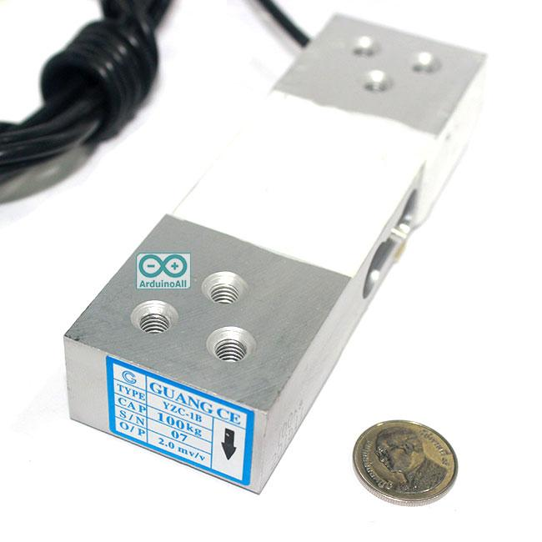
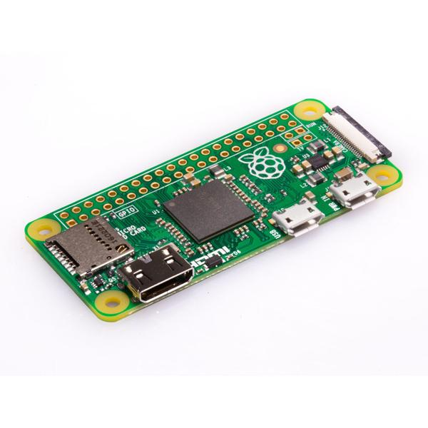
EQUIPMENT
Weight Sensor (Load Cell) 0-100 kg
Raspberry Pi

Slide 16
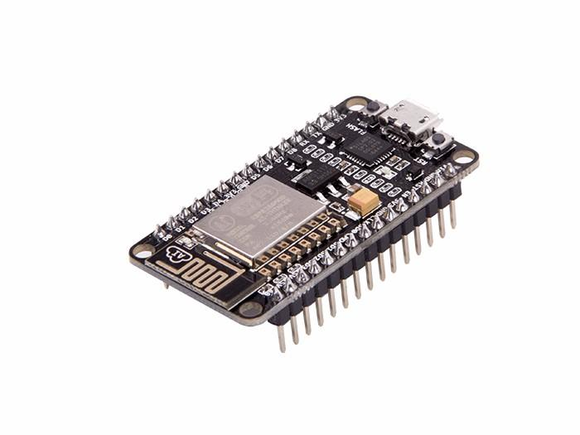
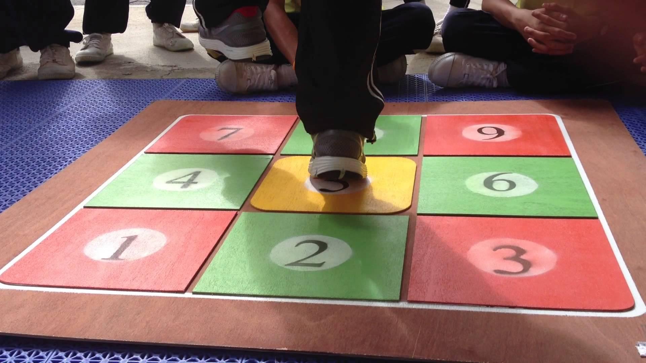
NodeMcu esp8266
9 Square board

Slide 17
REFERENCES
https://i.ytimg.com/vi/NaKMg1bQ-TI/maxresdefault.jpg
http://www.pngall.com/wp-content/uploads/2016/04/Server-PNG-Image.png
http://www.ku.ac.th/english/images/webnew/logo.jpg
https://img2.annthegran.com/StockDesign/XLarge/Dakota_Collectibles/sp0607.jpg
https://www.allaboutcircuits.com/projects/introduction-to-the-mqtt-protocol-on-nodemcu/

Slide 18
ANY QUESTION?

